Slide 1
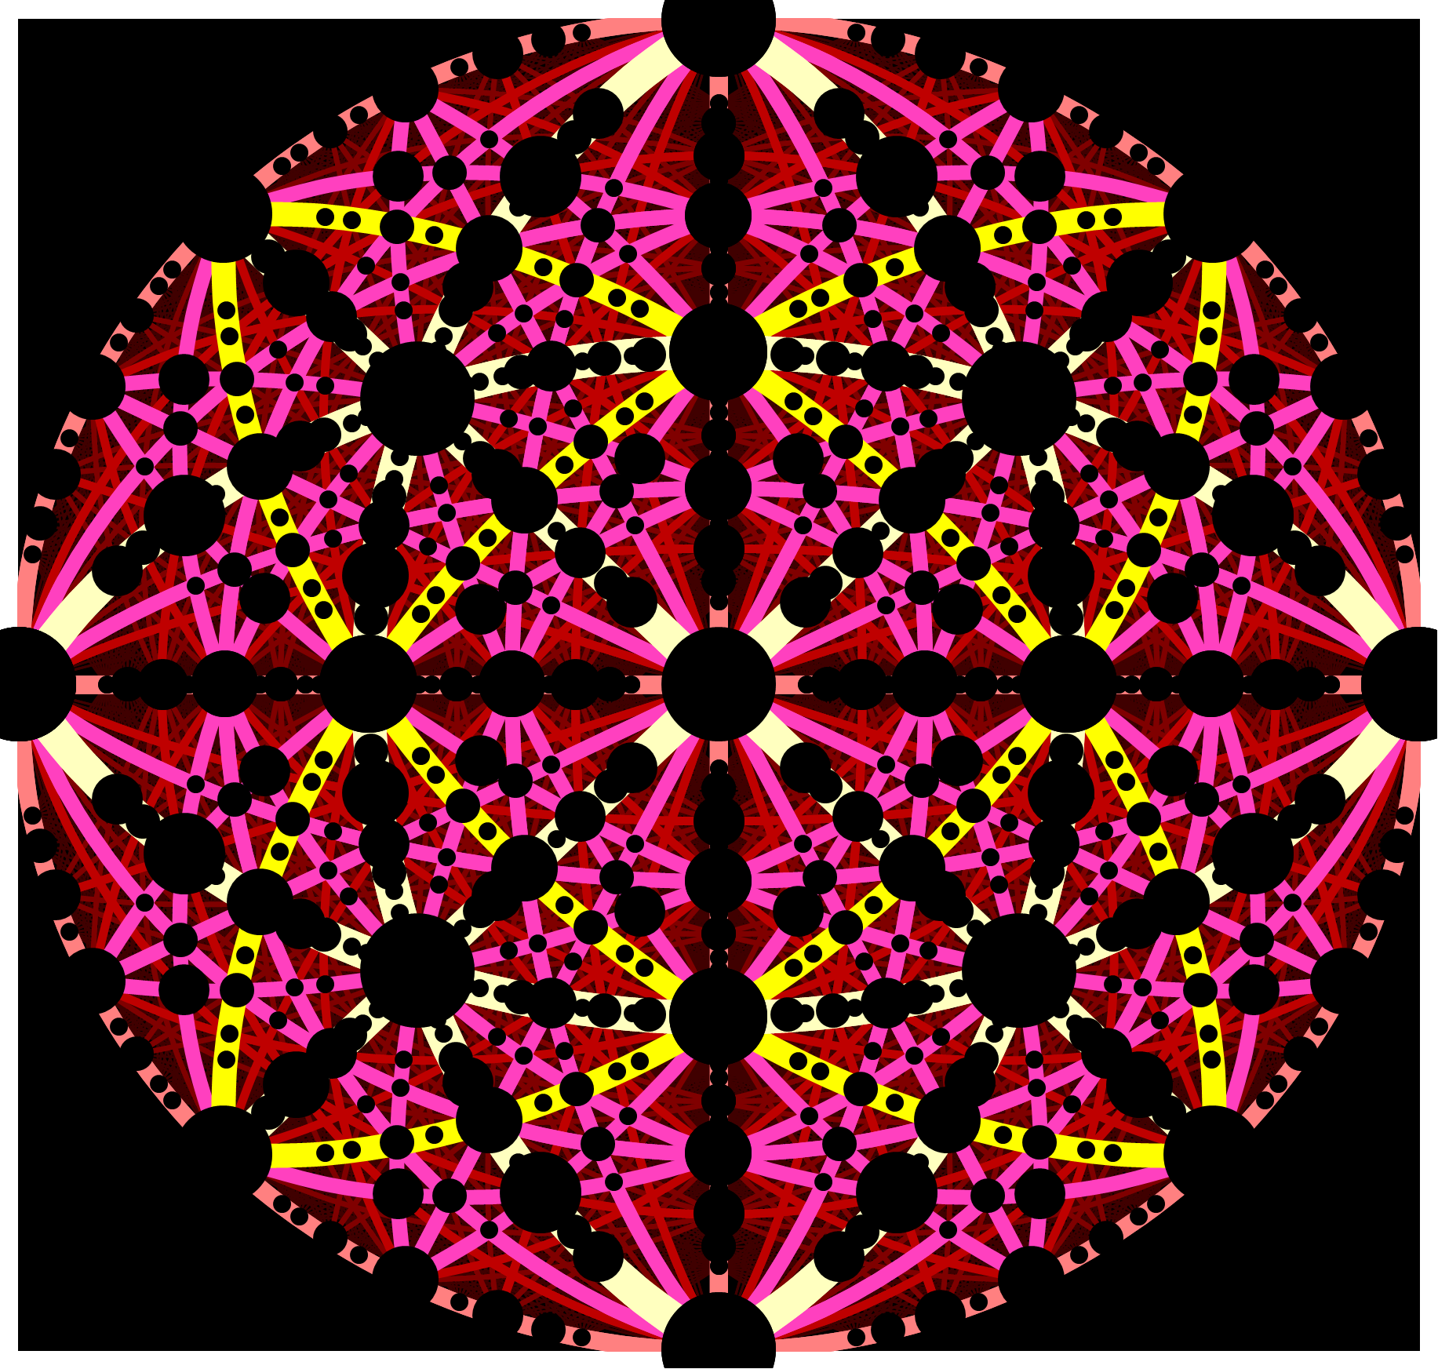
Ed Bielejec 505-206-0512
Barney Doyle 505-553-5044
Representation of ion channeling

Slide 2
Request to https://myit.sandia.gov/
the site is
https://www.sandia.gov/research/research-foundations/materials-science/materials-facilities/ion-beam-modification/ion-beam-analysis/
and the links that no longer work are:
Ion Beam Analysis (IBA) Periodic Table (HTML)
TUNL Nuclear Data Evaluation
The TUNL link should be https://nucldata.tunl.duke.edu/
Delete the RUMP link
The SIMNRA should be https://mam.home.ipp.mpg.de/
The table was an interactive HTML app at: https://www.sandia.gov/research/facilities/technology_deployment_centers/ion_beam_lab/ion_beam_analysis_periodic_table.html that has somehow gotten lost maybe in the reorganization from Center 1100 to 1800 a few years ago. I would be great if you could find it, but if not I could send you a powerpoint of the main screen, but it wouldnt be interactive.
This website is used internationally by accelerator groups that perform IBA

